Slide 1


IP rights as a business booster-
The Malaysian Perspective
(strictly not for circulation)
14-15 February 2015 ⎮ Ahmedabad, India

Slide 2

What is Intellectual Property?
A legal concept that deals with the creations of the mind
Property in intangible form
A bridge connecting inventions with businesses/ the market
Most important asset for a business

Slide 3
What is Intellectual Property?
Q: How does it boost business?
Provide a competitive advantage
Deter competition
Effective marketing tool
Assist in generating income
Continuous research and development

Slide 4
The IP system in Malaysia
Governed by laws in Malaysia
Patent Act 1983
Trade Marks Act 1976
Industrial Design Act 2011
Copyright Act 1987
Regulatory body is Malaysian IP Office

Slide 5

1. Patent
Fixed-term agreement with the state
Monopoly in exchange for disclosure
Territorial in nature
Protects inventions in a field of technology

Slide 6
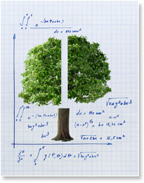
What is an invention?
An idea which permits in practice the solution to a problem in a technical field
Relate to a technical field
Defined by technical features
Satisfy patentability requirements

Slide 7
Patentability requirements
      Novelty
      Inventive step
      Industrial applicability
d

Slide 8
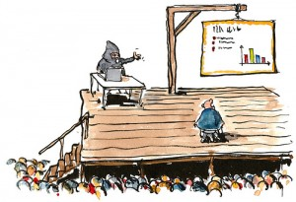
Patentability requirements
  Novelty (new)
New if not anticipated by prior art
PUBLIC disclosure of invention,
BY ANYONE,
ANYWHERE in the world,
BY ANY MEANS,
before filing first application
Death by Presentation

Slide 9
Patentability requirements
Inventive step
Assessment of obviousness
Q: Would the combination of features of your invention be obvious to a person having ordinary skill in your field of technology ?

Slide 10
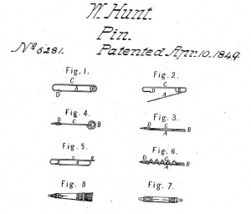
Patentability requirements
Inventive step
(All ima

Slide 11
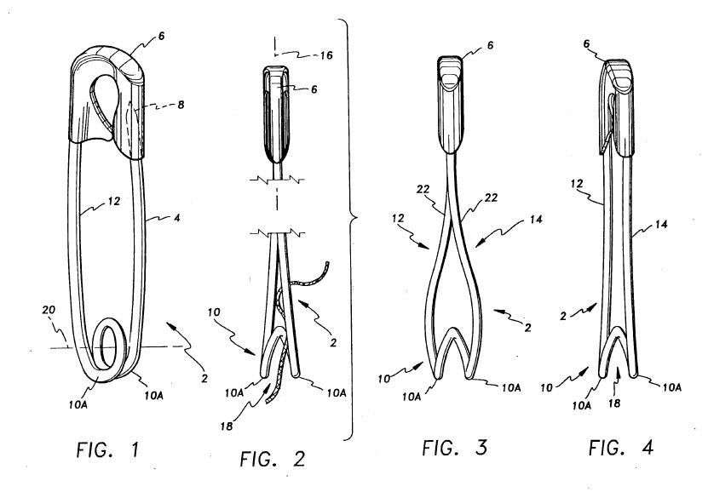
Patentability requirements
    Inventive step

Slide 12
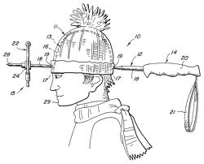
Patentability requirements
Industrial applicability
Invention can be made or used in any
industry
Normally not an issue

Slide 13
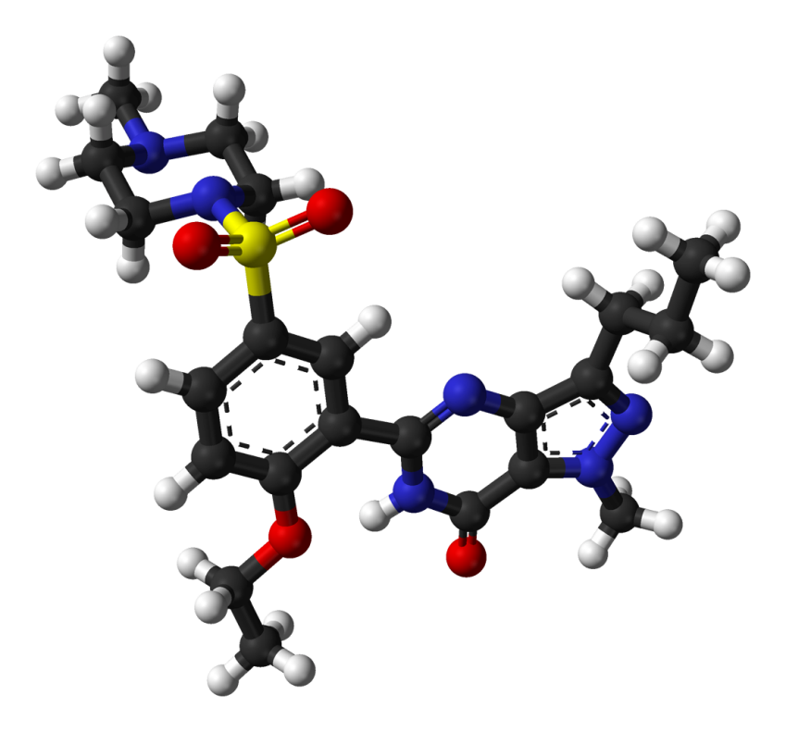

Example of a Patented product
3D model of sildenafil molecule based on crystal structure of sildenafil citrate monohydrate
Sildenafil citrate
Was it new?
Was it obvious?
Was it industrially applicable?

Slide 14
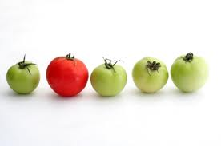




Non-patentable inventions
      Excluded subject matter - Malaysia

Slide 15
Non-patentable inventions
      Excluded subject matter
      Discoveries, scientific theories & mathematical methods
      Plant or animal varieties & essentially biological processes for production of plants or animals
      Schemes, rules or methods for doing business
      Methods for performing purely mental acts or playing games
      Methods for treatment of human or animal body by surgery or therapy & diagnostic methods
      Section 13(1) Malaysian Patents Act

Slide 16
Pre-filing considerations
Patentability requirements
(novelty, inventive step, industrial applicability)
Pre-filing search
Drafting of patent specification
(see example)

Slide 17
Dos & Don'ts
Dos
Invention write-up should focus on:
New features of invention
Technical problems solved
Advantages over existing solutions (if any)

Slide 18
Dos & Don'ts
Extra Dos
Provide information on:
All ways the invention may be executed
(different variations, embodiments etc)
Working examples e.g. test data
Drawings

Slide 19
2. Industrial Design
What is an Industrial Design ?
An Industrial design consists of features of shape, configuration, pattern or ornament applied to an article by an industrial process
Eye appeal

Slide 20


Industrial Design
2D features include
pattern, ornament applied to an article

Slide 21
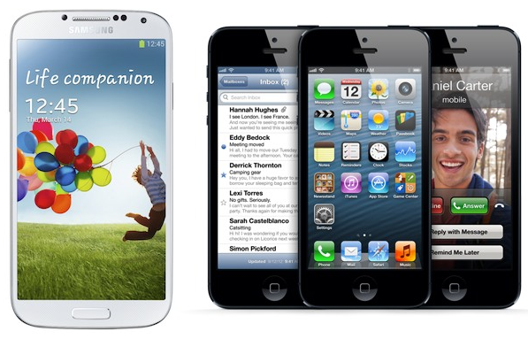
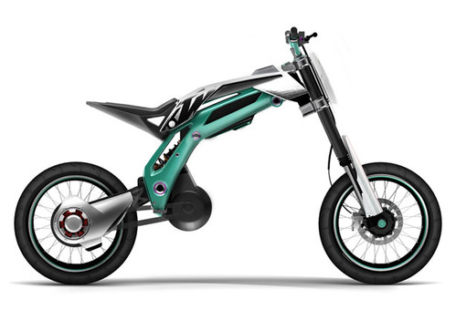
Industrial Design
3D features include

Slide 22
Registrability requirements
To qualify for registration, the design must:
Belong to the Applicant
Be applied to an article
Be Novel – worldwide novelty

Slide 23
Registrability requirements
Belongs to the Applicant
AUTHOR – Person who creates a design
OWNER – Person who is registered as the owner of the registered industrial design and may be a natural or legal person
You can only file the design if it belongs to you

Slide 24
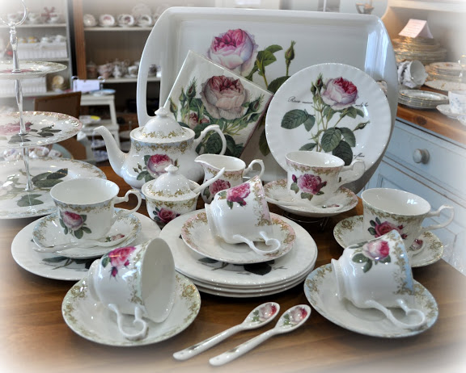
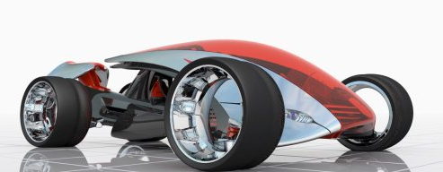
Registrability requirements
Applied to an article
Article - any article of manufacture or handicraft, including any part of such article or handicraft if that part is made and sold separately.

Slide 25

Registrability requirements
Novelty – No public disclosure of the industrial design has taken place in Malaysia or elsewhere before filing date
  - Worldwide novelty

Slide 26
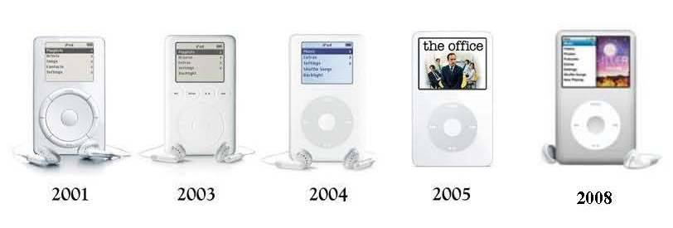
Scope of Protection - Design
Incremental design
(All images shown are for illustration purposes only)

Slide 27
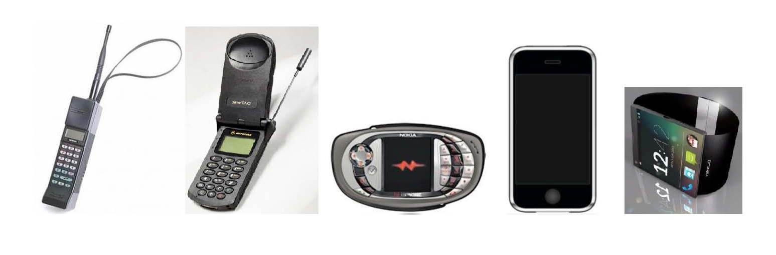
Scope of Protection - Design
1987
1998
2004
2007
2014
Revolutionary Designs
(All images shown are for illustration purposes only)

Slide 28
Patents & Designs – a comparison
 | Patent | Registered Design
What is it? | Monopoly granted by the state in exchange for disclosure
What is protected? | Invention of a product or process Technical features | Outer appearance of a mass-produced article Aesthetic features
Term of Protection | 20 years | 25 years

Slide 29
Patents & Designs – a comparison
 | Patent | Registered Design
Protectable Subject-Matter | Invention idea of inventor with practical application that solves a problem in a field of technology | Design shape or surface decoration applied to an article that gives eye appeal
Registrability Requirements | Novelty Inventive Step Industrial Application | Novelty

Slide 30
Patents & Designs – a comparison
Requirement | Patent | Design
Novelty | not previously made public anywhere in any way by any person before the application for registration is filed
Inventive Step | the differences that make the invention new are not trivial or obvious ones
Industrial Application | can be made or used in industry

Slide 31
Patents & Designs – a comparison
Stage | Patent | Design
Application | Forms + Fees + Specification | Forms + Fees + Representations
Foreign Filing Term | 12 months | 6 months
Publication | Yes | No
Examination Request | Required | Not required, automatic
Examination Type/Prosecution | Substantive | Formality
Approval | Grant + Publication | Registration + Publication
Timeframe | 3-4 years | 6-12 months

Slide 32
Patents & Designs – a comparison
Comparison – Registrability, Scope & Cost
Patent | high registrability standard complex and expensive to obtain scope defined by words arguable as to meaning of the word
Design | low registrability standard relatively inexpensive to obtain scope defined by pictures arguable as to the overall impression

Slide 33
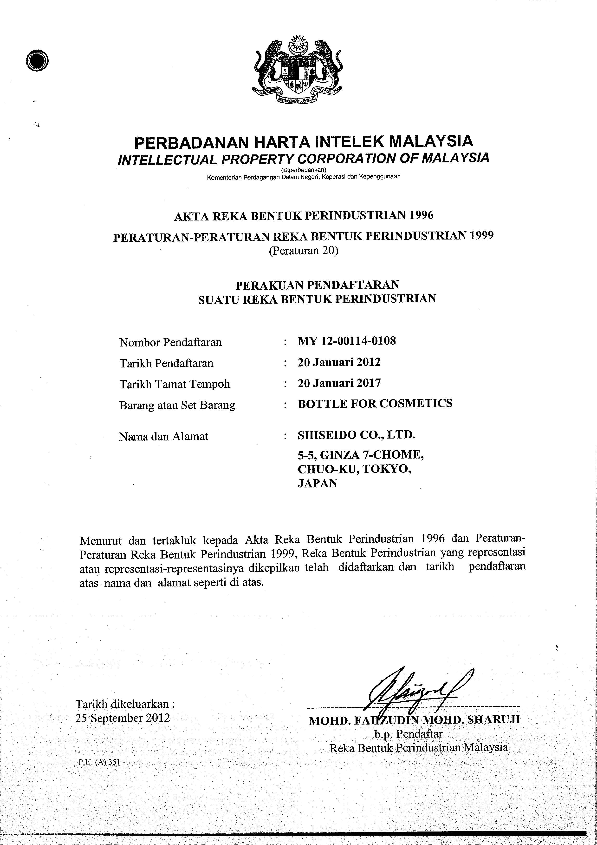
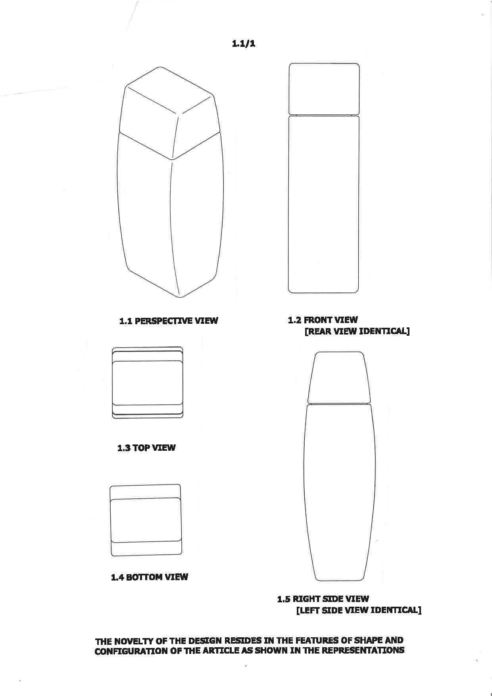
Anatomy of a Design Registration

Slide 34
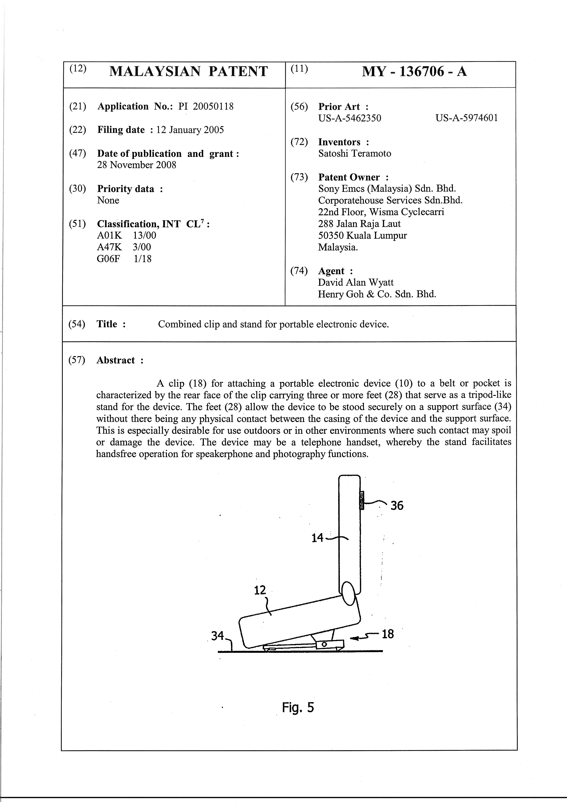
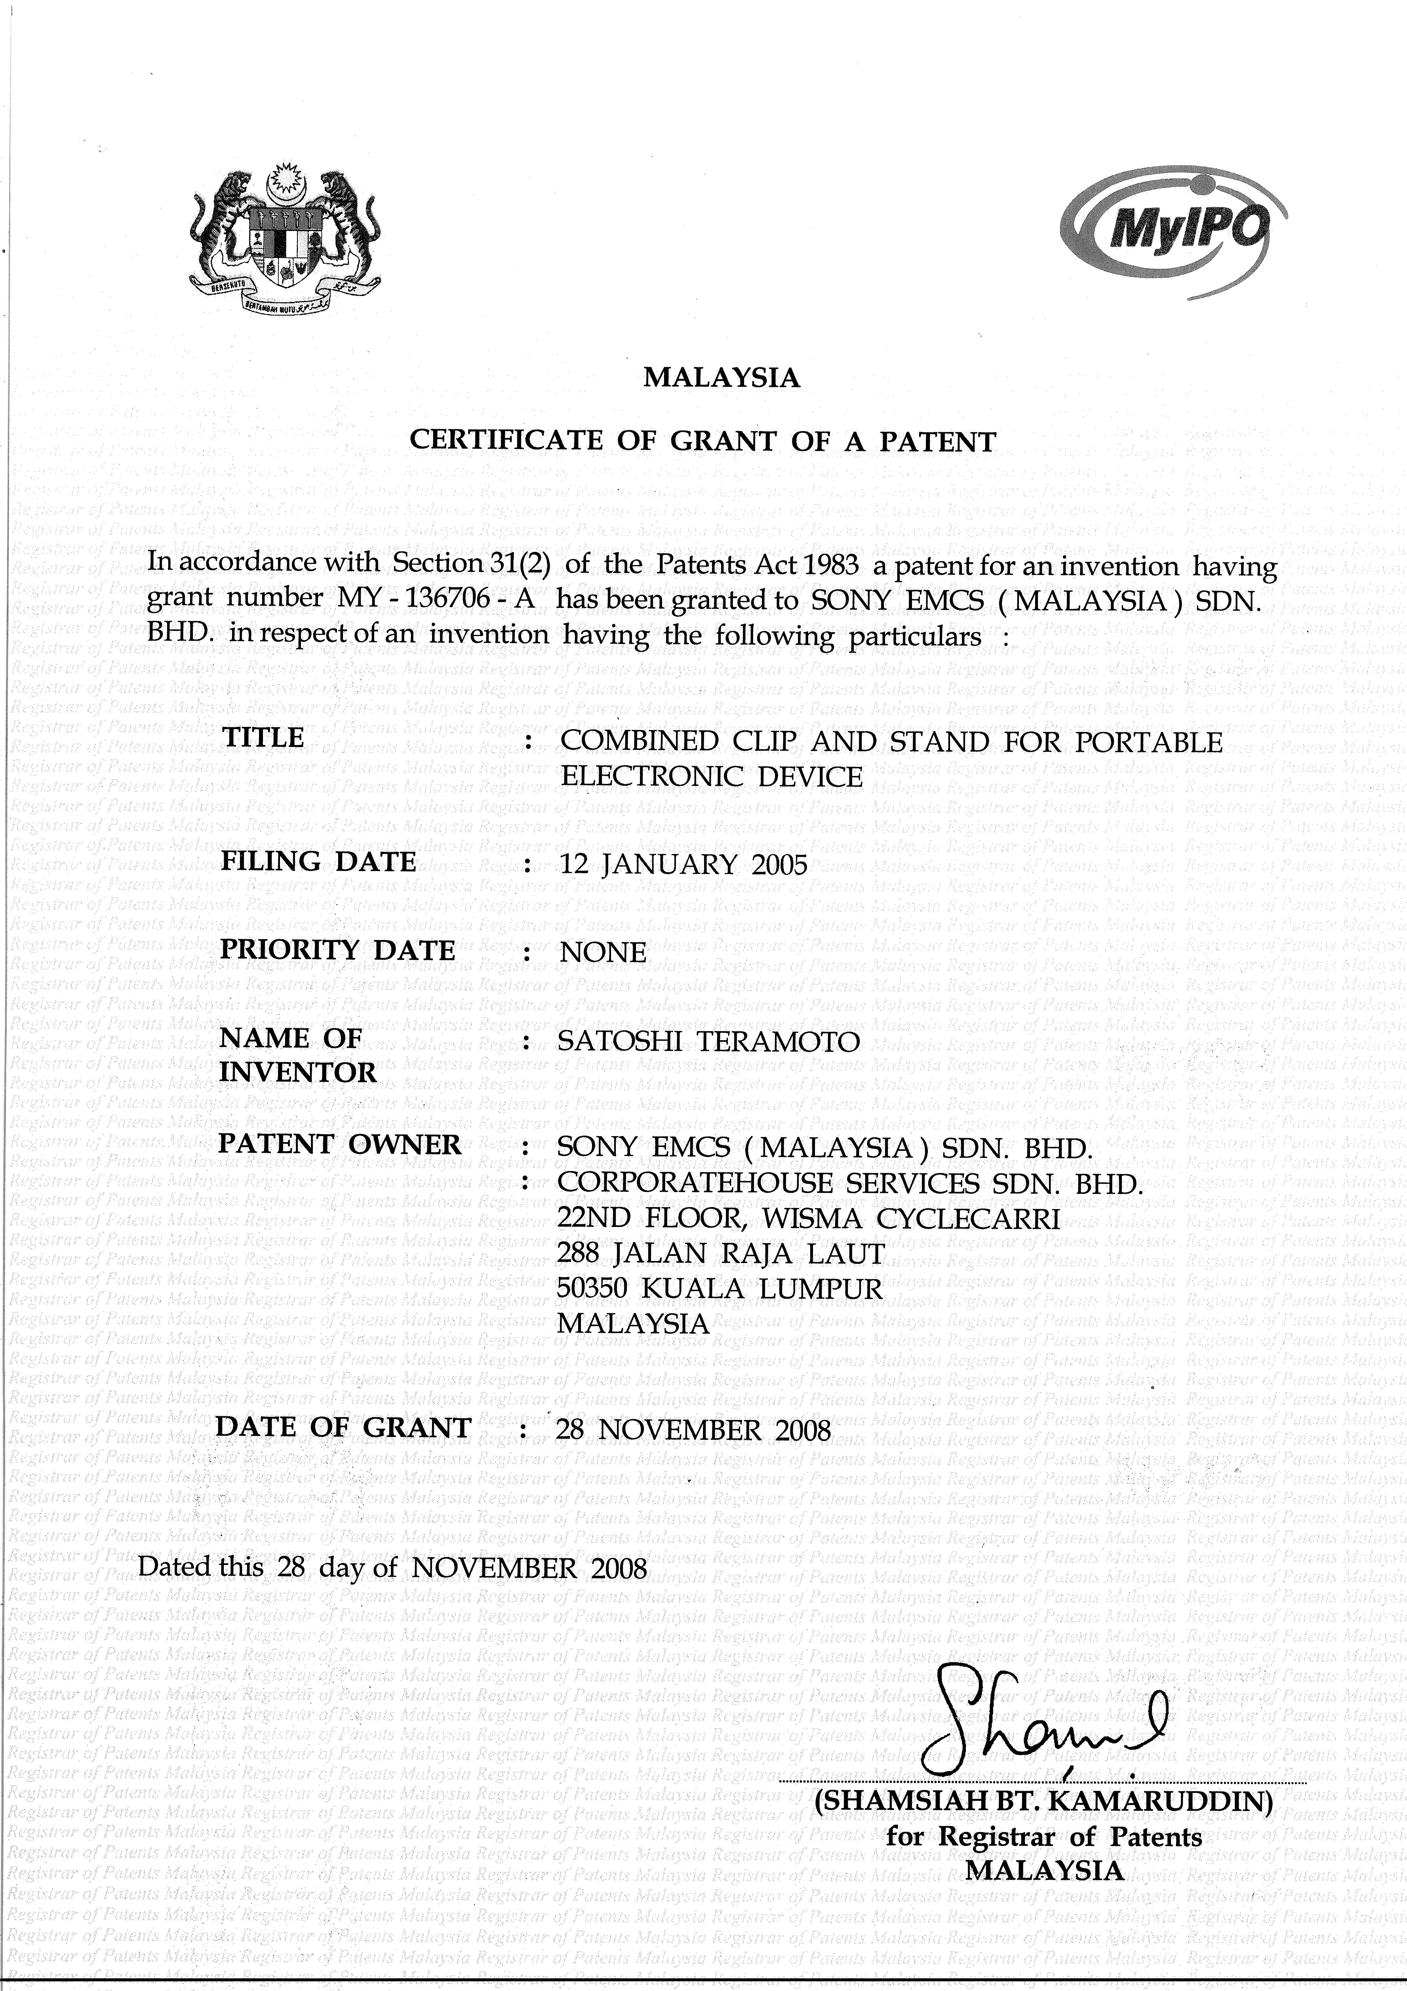
Anatomy of a Granted Patent

Slide 35
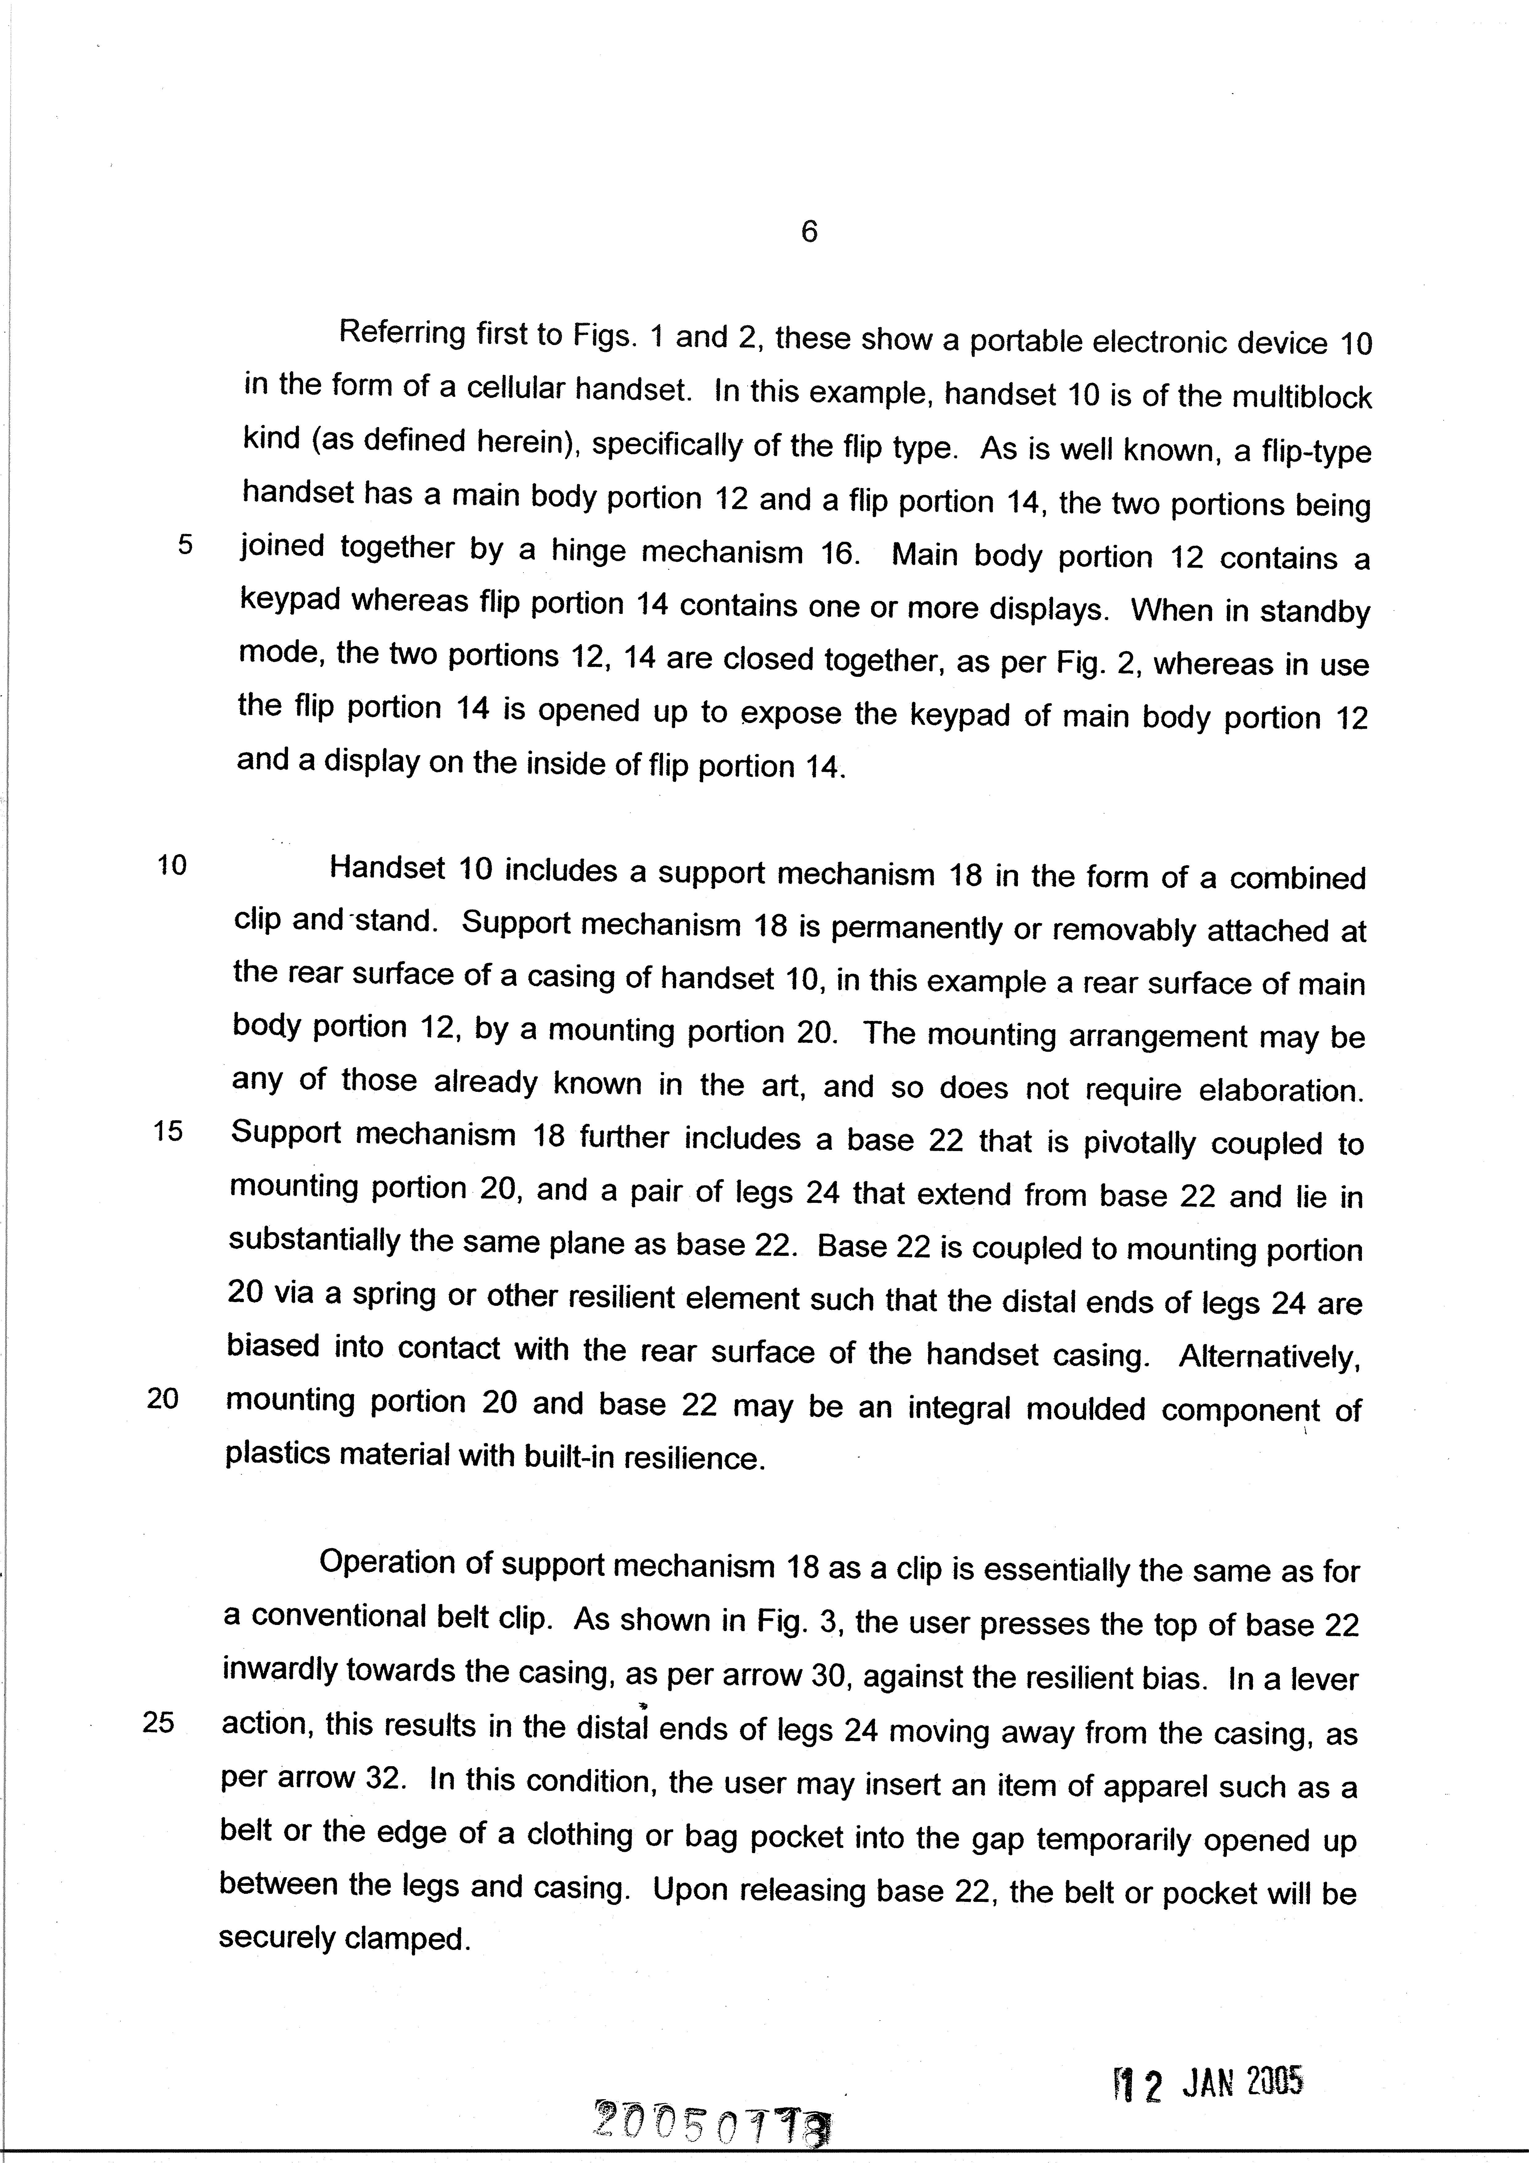
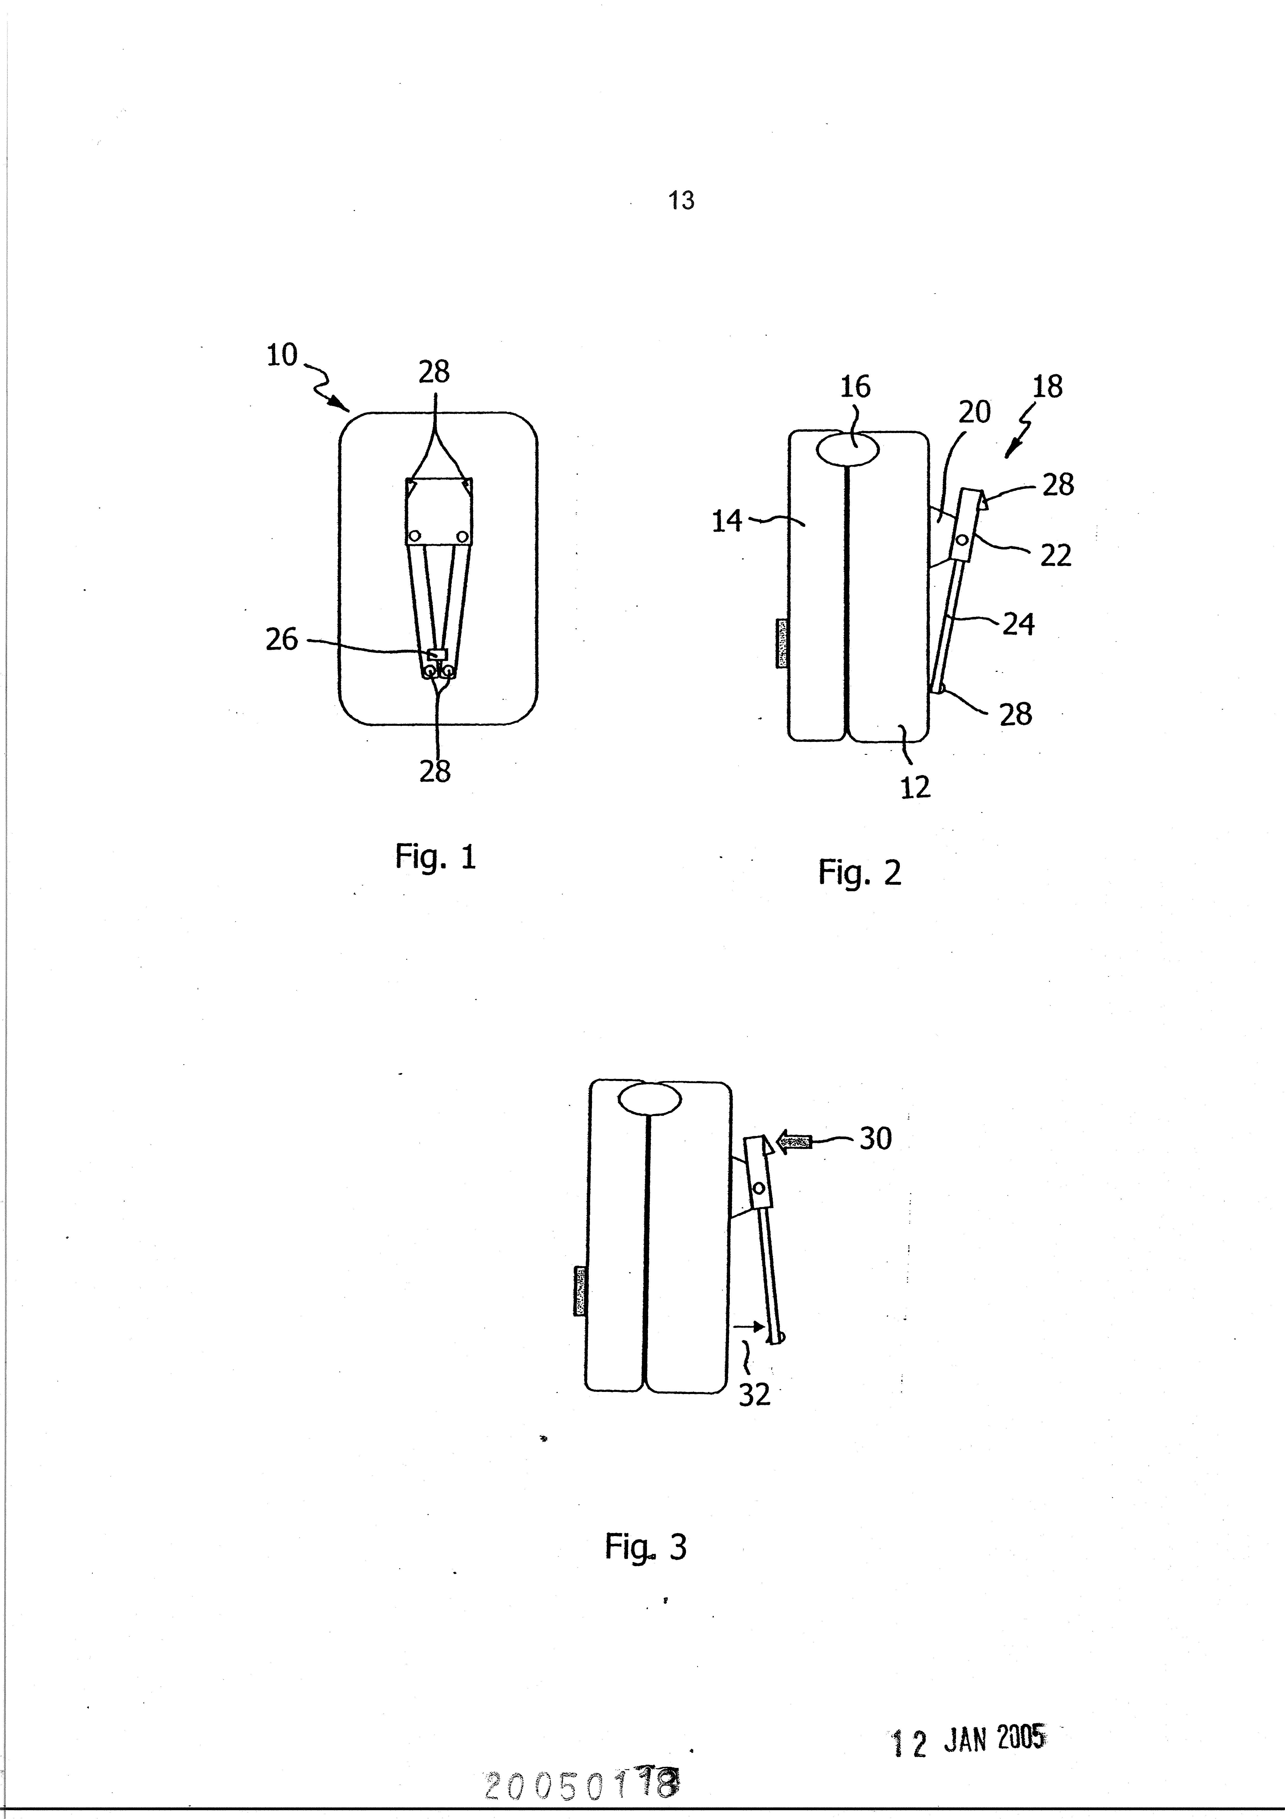
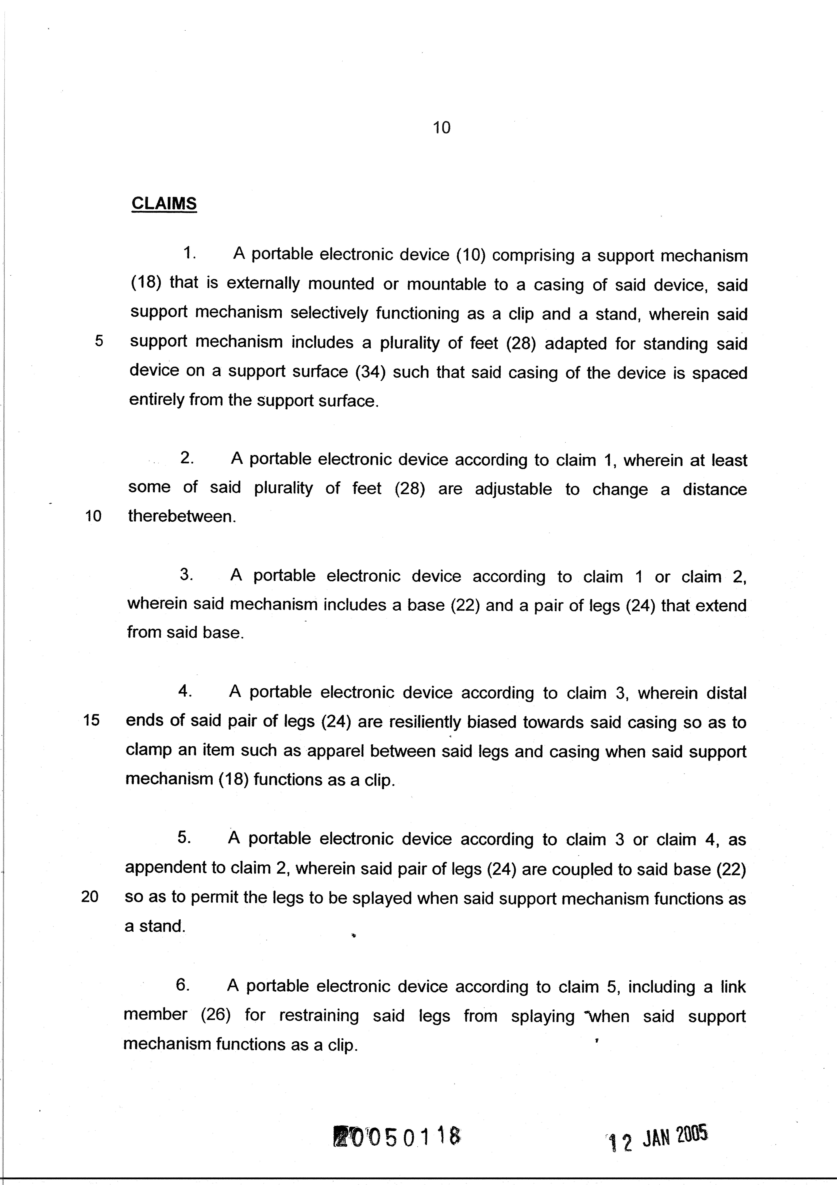
Anatomy of a Granted Patent
Anatomy of a Granted Patent
Copyright @ 2014 Henry Goh & Co Sdn Bhd

Slide 36
3. Trade Marks
Any sign or combination of signs used by a business to identify its goods or services to the public
Words that include names, letters, combination of colours, devices, logos
Visually perceptible i.e. 2D or 3D
Graphic representation

Slide 37







Examples of Malaysian Brands

Slide 38



Registrability Criteria
Section 10(1) of the Trade Marks Act
(a) the name of an individual, company or firm represented in a special or particular manner
(b) the signature of the Applicant for registration or of some predecessor in his business
(c) an invented word or words

Slide 39
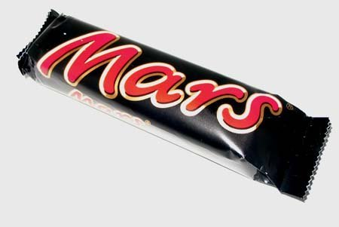


Registrability Criteria
(d) a word having no direct reference to the character or quality of the goods or services, not being, according to its ordinary meaning, a geographical name or surname, or
(e) any other distinctive mark

Slide 40







Non registrable Trade Marks
Hibiscus/Bunga Raya
ASEAN Logo
Malaysian Army; Royal Malaysian Navy/Air Force; Police
Red Cross/ Red Crescent
Communism symbol

Slide 41
Registration Process
File Application
Formalities Check
Search and Examination
Acceptance and Advertisement
Opposition
Registration
Renewal

Slide 42
Trade Marks Statistics
YEAR | APPLICATION |  |  | REGISTRATION
 | Malaysia | Foreign | Total | Malaysia | Foreign | Total
1934 -1982 | - | - | 162,415 | - | - | 132,273
1983 -1990 | 26,079 | 29,857 | 55,936 | 4,084 | 18,736 | 22,820
1991 | 3,707 | 4,616 | 8,323 | 357 | 1,463 | 1,820
1992 | 4,214 | 5,061 | 9,275 | 342 | 1,355 | 1,697
1993 | 5,056 | 5,209 | 10,265 | 766 | 2,247 | 3,013
1994 | 6,011 | 6,334 | 12,345 | 1,789 | 6,166 | 7,955
1995 | 6,861 | 7,242 | 14,103 | 2,399 | 7,013 | 9,412
1996 | 7,329 | 8,243 | 15,572 | 1,258 | 2,759 | 4,017
1997 | 9,042 | 13,087 | 22,129 | 1,082 | 2,537 | 3,619
1998 | 4,063 | 10,813 | 14,876 | 1,521 | 2,869 | 4,390
1999 | 5,053 | 8,660 | 13,713 | 439 | 1,226 | 1,665
2000 | 6,303 | 12,500 | 18,803 | 449 | 1,328 | 1,777
2001 | 6,525 | 10,078 | 16,603 | 1,570 | 5,341 | 6,911
2002 | 7,661 | 8,785 | 16,446 | 4,056 | 7,072 | 11,128
2003 | 8,327 | 9,439 | 17,766 | 3,014 | 9,108 | 12,122
2004 | 10,406 | 10,337 | 20,743 | 3,243 | 8,473 | 11,716
2005 | 10,479 | 11,668 | 22,147 | 3,683 | 7,771 | 11,454
2006 | 11,209 | 12,840 | 24,049 | 5,651 | 10,108 | 15,759
2007 | 12,289 | 13,605 | 25,894 | 8,108 | 17,382 | 25,490
2008 | 12,562 | 13,472 | 26,034 | 9,049 | 18,798 | 27,847
2009 | 12,810 | 11,260 | 24,070 | 5,438 | 9,534 | 14,972
2010 | 13,099 | 13,271 | 26,370 | 5,642 | 8,652 | 14,294
2011 | 13,001 | 15,832 | 28,833 | 10,201 | 13,618 | 23,819
2012 | 14,044 | 17,832 | 31,876 | 9,765 | 16,311 | 26,076
2013 | 14,705 | 17,520 | 32,225 | 9,777 | 17,202 | 26,979
NOV 2014 | 13,959 | 17,203 | 31,162 | 9,476 | 15,401 | 24,877
Total | 244,794 | 294,764 | 701,973 | 103,159 | 212,470 | 447,902

Slide 43
4. Copyright
Non registrable right

Slide 44

Berne Convention 1886
167 member states
Malaysia joined in October 1990
No formal registration required
Automatic protection in member states
  Subject matter
  Original endeavour
  Reduced to a material form

Slide 45

Literary Works
Books
Brochures
Manuals
Letters
Tables or compilations
Computer programs

Slide 46



Artistic Works
Graphics/Drawings
Photographs
Sculpture
Architecture

Slide 47
Derivative Works
Derived from any pre-existing copyright works:
Translation
Adaptation
Arrangement
Collection of works

Slide 48
Ownership of Copyright
Presumption of Ownership
Author – creator of the work
Owner – person entitled to control the work

Slide 49
Ownership of Copyright
Commissioned Work:
Ownership is transferred from the author to
the person who commissioned the work
Work made in employment:
Ownership lies with the author’s employer
* in the absence of any agreement to the contrary

Slide 50

Duration
Literary, musical or artistic works – life of the author plus 50 years
Other works – 50 years from publication

Slide 51
Voluntary Notification (VN)
Effective 01 June 2012
Owner may file for VN at MyIPO
Copyright Notification Certificate issued
Prima facie evidence of ownership

Slide 52
Application for VN
Information necessary for filing
Details of authorship
Title of work (National language, English or translation)
Date of publication
Date of death of author ( if deceased)
Consent to research & educational use
Applicant’s signature ( to validate appointment)

Slide 53
Application for VN
Statutory Declaration also required
To assert and affirm ownership
To exhibit a copy of the work
Different medium of deposits available i.e. hardcopies, CDs, DVDs and thumb drive

Slide 54
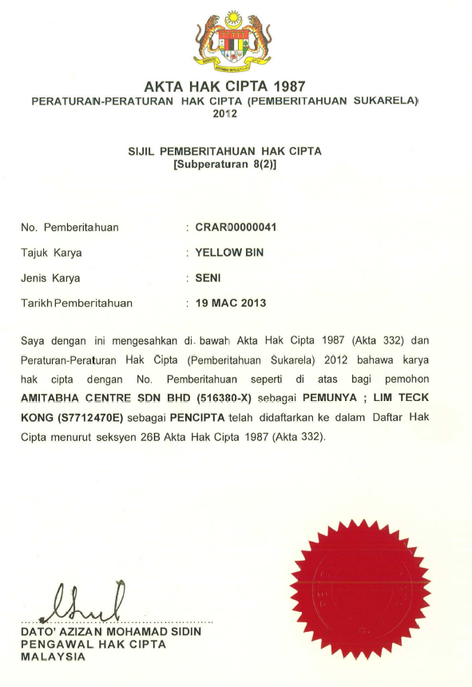
Voluntary Notification

Slide 55
Thank you
Copyright © 2015 Henry Goh & Co Sdn Bhd
www.henrygoh.com

